Slide 1
Cosmos-Y

Slide 2
Contents:
01
Our team
Stages of realization
03
Used technologies
02

Slide 3
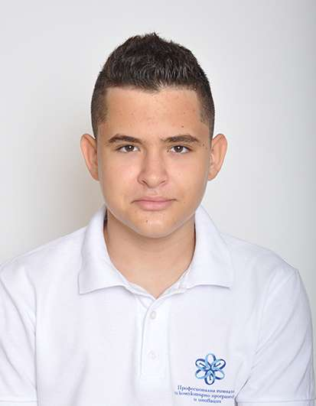
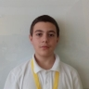
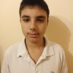
Our Team:
Velizar Mihailov
Martin Shavov​
Anton Babev
Frontend developer
Scrum Trainer
Frontend developer

Slide 4
02 Stages of Realization
Decide on the idea
Organization
Development
Presentation

Slide 5






03 Used Technologies

Slide 6
Thank you for your attention!

